Slide 1


Write LESS CSS and make it SASSier
Jake Adams
Thompson Coburn LLP

Slide 2







































Platinum Sponsors
Gold Sponsors
Silver Sponsors

Slide 3
About Me
Jake Adams
Senior Programmer Analyst
Thompson Coburn LLP
email: jacobladams@gmail.com
twitter: @jacobladams
geekswithblogs.com/jacobladams
github.com/jacobladams
Speakerrate.com/jacobladams

Slide 4
Overview
What
Why
SASS and LESS Setup
Variables
Mixins
Functions
Etc.
Advanced
Links

Slide 5
What are SASS and LESS?
“CSS extension”
“CSS Preprocessors”
“Higher Level CSS Languages”
“CSS Frameworks”

Slide 6
What are SASS and LESS

Slide 7
Why?
DRY Principle
D on’t
R epeat
Y ourself

Slide 8
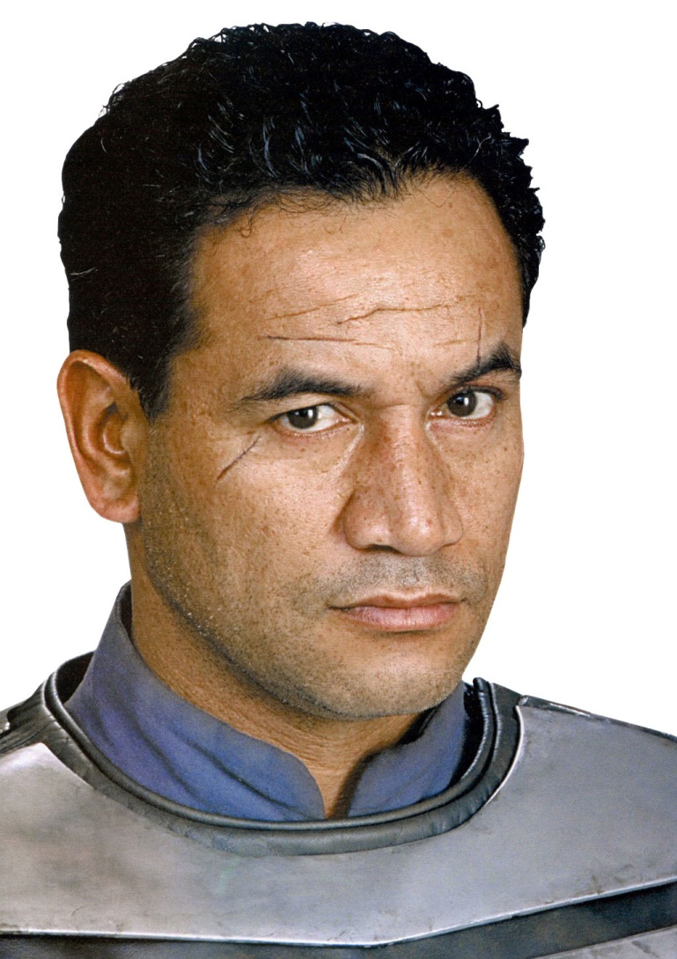
Don’t Repeat Yourself
Reduce Typing
Improve Maintainability
Reduce Errors

Slide 9

Make the machines work for you, not vice versa…

Slide 10
How?
Install Tools
Usage
1) Command line - one time compile
2) Command line - watch file/folder
3) Dynamic compile/Plugin

Slide 11
When to compile?

Slide 12



Install SASS
SASS in written in Ruby
1) Install Ruby via Ruby Windows Installer
2) From command line
gem install sass
s
1) Install IronRuby
2) From command line (as administrator)
igem install sass

Slide 13
SASS Command Line Usage
One time compile
sass myStyleSheet.scss myStyleSheet.css
Watch file
sass --watch myStyleSheet.scss:myStyleSheet.css
Watch directory of Sass files
sass --watch app/sass:public/stylesheets

Slide 14



Install LESS
LESS is primarily written in JavaScript
Include less-1.3.0.min.js in html and .less file with be compiled at run time. Compile .less
Node.js
Dotless

Slide 15
Install LESS

Slide 16
Variables

Slide 17
Mixins

Slide 18
How

Slide 19
Ways to Compile

Slide 20
Variables

Slide 21
Variables

Slide 22
Mixins

Slide 23
Parametric Mixins

Slide 24
Selector Inheritence

Slide 25
Nesting

Slide 26
Operations

Slide 27
Functions

Slide 28
Comments

Slide 29
Imports

Slide 30
String Interpolation?

Slide 31
Differences

Slide 32
Advanced Features

Slide 33
Links
Ruby Installer
SassAndCoffee
Sass
Less

Slide 34
Contact

